Slide 1
Continuous Psychophysics
What? Why? How?

Slide 2
Continuous Psychophysics: How and Why and Why not
Björn Jörges
Notes:
Today I will be putting together a little method that has received a bunch of attention lately, Continuous Psychophysics, with one of the alltime fave model processes to study multisensory integration, the perception of the direction in which we are moving, or heading perception.

Slide 3
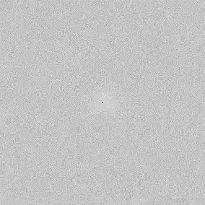
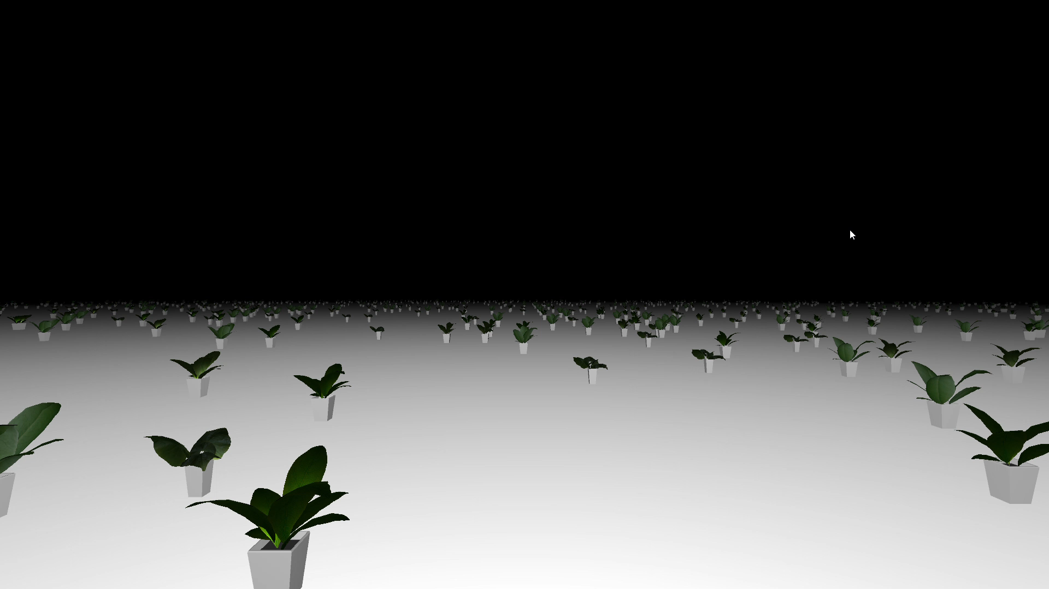
Continuous Psychophysics
Coupling a continuous stimulus with a continuous response
Notes:
Now, there is this new paradigm in vision science, Continuous Psychophysics, that allows us to pretty naturally look at the time course of perception, including whether having more information about an organisms heading can speed up the underlying evidence accumulation. Continuous psychophysics, it‘s kind of an emerging paradigm, so I would say the boundaries are a little fuzzy, but in general the defining feature is that you couple a continuous stimulus with a continuous response, and it‘s been done for a bunch of tasks like tracking a dot with a finger, nulling self-motion, smooth pursuit eye-movements and others.
Discussing the method in detail unfortunately goes beyond the scope of this little 12 minute talk, but I wanted to mention some advantages and disadvantages. It‘s definitely a fast way to collect lots of data, it‘s pretty natural to assess the time course of perceptual processes, it gives us more tools to design our studies more naturalistically, and it‘s SO MUCH less awful for the participants.
On the flipside, you have to jump through a couple of hoops to analyze the data (which we will see later), although we use psychometric functions with all their complexities all the time, so I guess we can deal with it. Another problem is that motor variability is a larger share of the overall variability in the data, so you can run into problems if your manipulation might affect the motor component of the task.

Slide 4
The seminal study: Bonnen et al. (2015)
Participants tracked a dot blurred with Gaussian noise with a red cursor
Different degrees of noise
The dot moved as a random walk (sd = 1 pixel per frame)

Slide 5
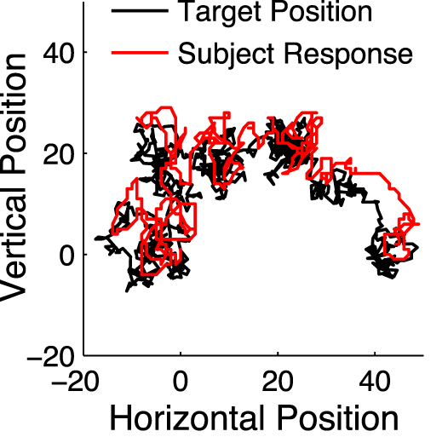
Results

Slide 6
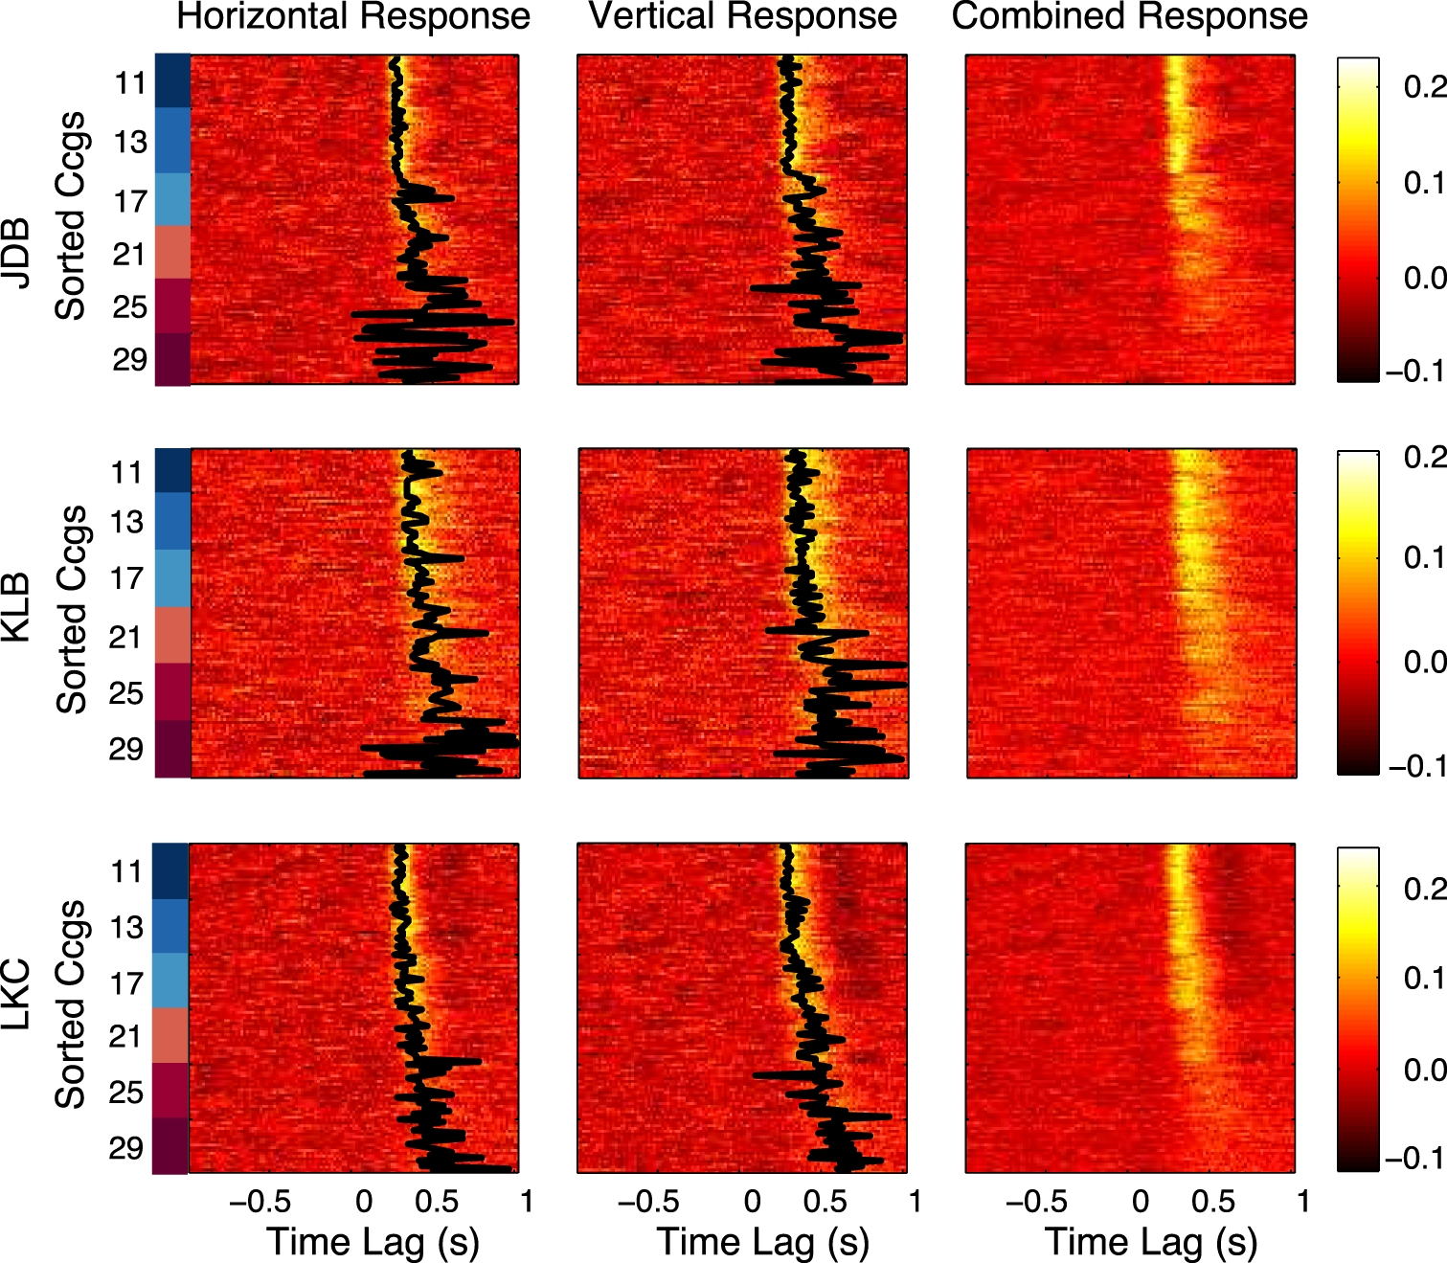
Results

Slide 7
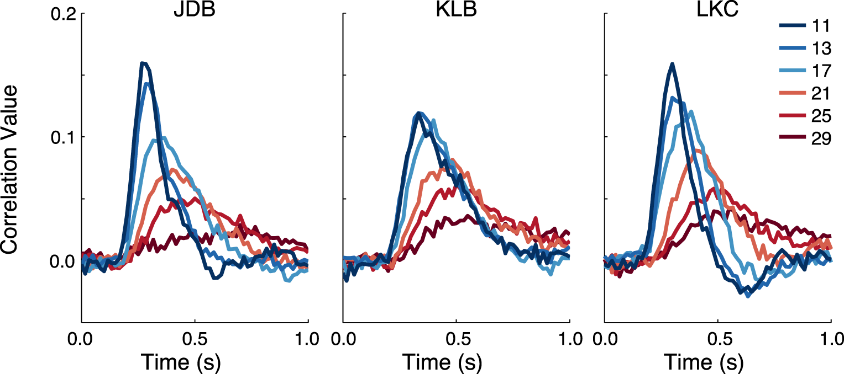
Results

Slide 8
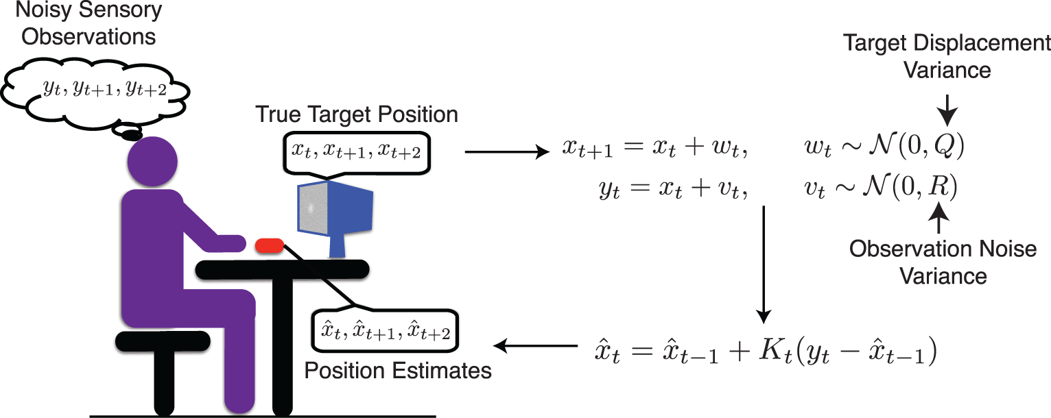
Kalman Filter

Slide 9
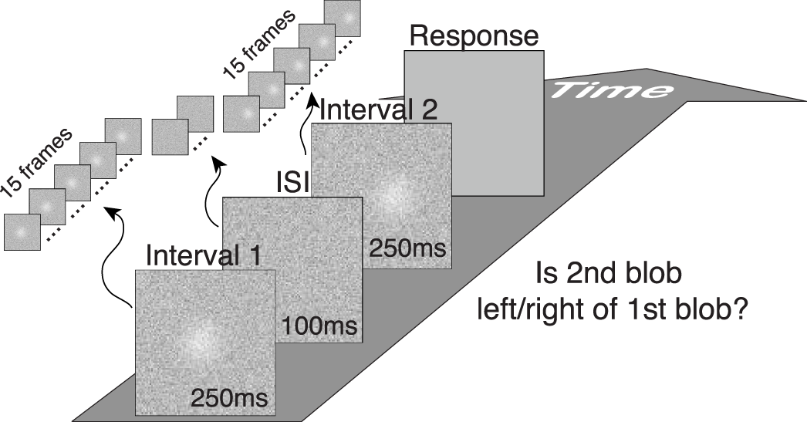
Comparison to Traditional Psychophysics

Slide 10
Comparison
97% of variability in 2AFC explained by variability in Kalman filter sensitivity estimate
Pretty good correlation as well with width of CCG curves

Slide 11
Continuous Psychophysics: Advantages
Fast way to collect lots of data
Intuitive way to assess time course of perception
Another option for more naturalistic experiments
Less torturous for participants
Notes:
Now, there is this new paradigm in vision science, Continuous Psychophysics, that allows us to pretty naturally look at the time course of perception, including whether having more information about an organisms heading can speed up the underlying evidence accumulation. Continuous psychophysics, it‘s kind of an emerging paradigm, so I would say the boundaries are a little fuzzy, but in general the defining feature is that you couple a continuous stimulus with a continuous response, and it‘s been done for a bunch of tasks like tracking a dot with a finger, nulling self-motion, smooth pursuit eye-movements and others.
Discussing the method in detail unfortunately goes beyond the scope of this little 12 minute talk, but I wanted to mention some advantages and disadvantages. It‘s definitely a fast way to collect lots of data, it‘s pretty natural to assess the time course of perceptual processes, it gives us more tools to design our studies more naturalistically, and it‘s SO MUCH less awful for the participants.
On the flipside, you have to jump through a couple of hoops to analyze the data (which we will see later), although we use psychometric functions with all their complexities all the time, so I guess we can deal with it. Another problem is that motor variability is a larger share of the overall variability in the data, so you can run into problems if your manipulation might affect the motor component of the task.

Slide 12
Continuous Psychophysics: Disadvantages
Challenging to analyze, maybe
More susceptible to influences of the motor system (Falconbridge 2024, Straub & Rothkopf 2022)

Slide 13
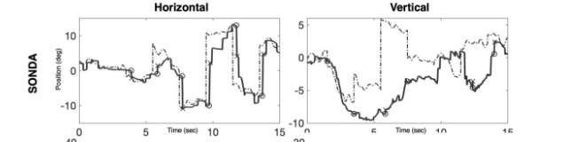
Continuous Psychophysics: Eye-Movements
Grillini, A., Koens, L. H., Lizaitiene, G., Lange, F., Cornelissen, F. W., & Tijssen, M. A. J. (2022). Measuring saccades in patients with Niemann-Pick type C: A comparison between video-oculography and a novel eye tracking test based on continuous psychophysics. Clinical Parkinsonism and Related Disorders, 7. https://doi.org/10.1016/j.prdoa.2022.100170

Slide 14
Continuous Psychophysics: Eye-Movements
Grillini, A., Koens, L. H., Lizaitiene, G., Lange, F., Cornelissen, F. W., & Tijssen, M. A. J. (2022). Measuring saccades in patients with Niemann-Pick type C: A comparison between video-oculography and a novel eye tracking test based on continuous psychophysics. Clinical Parkinsonism and Related Disorders, 7. https://doi.org/10.1016/j.prdoa.2022.100170

Slide 15

Continuous Psychophysics: Background motion
Videos: https://journals.sagepub.com/doi/10.1177/20416695231214439
Falconbridge, M., Stamps, R. L., Edwards, M., & Badcock, D. R. (2023). Target motion misjudgments reflect a misperception of the background; revealed using continuous psychophysics. I-Perception, 14(6). https://doi.org/10.1177/20416695231214439

Slide 16
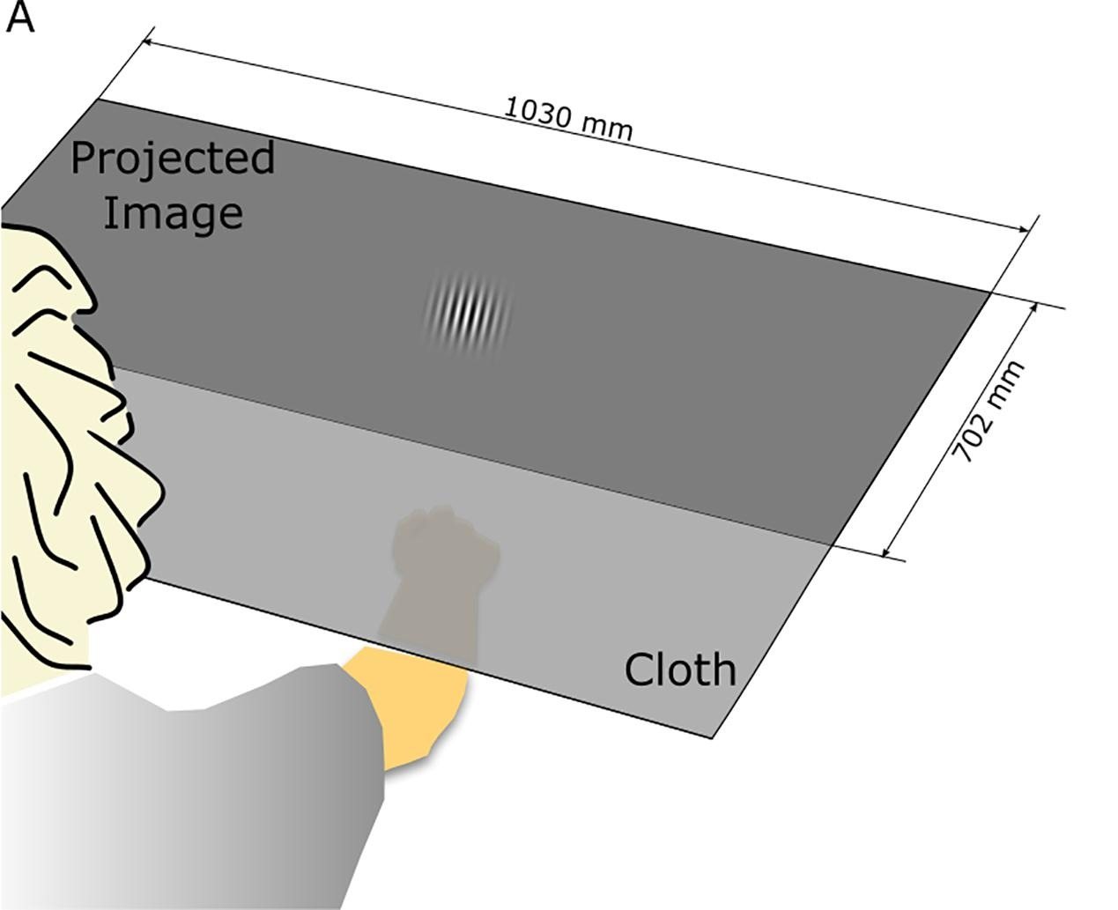
Continuous Psychophysics: manual tracking
Décima, A. P., Barraza, J. F., & López-Moliner, J. (2022). The perceptual dynamics of the contrast induced speed bias. Vision Research, 191. https://doi.org/10.1016/j.visres.2021.107966

Slide 17
Studying Precision and Temporal Dynamics of Heading Perception with Continuous Psychophysics
Björn Jörges, Ambika Bansal, Laurence R. Harris
Notes:
Today I will be putting together a little method that has received a bunch of attention lately, Continuous Psychophysics, with one of the alltime fave model processes to study multisensory integration, the perception of the direction in which we are moving, or heading perception.

Slide 18
Heading Perception
Multisensory process (visual, vestibular, auditory, ...) to determine the direction in which the organism is moving
Different models (Kalman filters, Drift Diffusion models) make the prediction that, when heading cues are more informative, judgements should be:
More precise
Faster
Notes:
Heading perception is a multisensory process where vision and the vestibular system play, pretty, naturally, prominent roles, but there is also evidence that other modalities, like sound or haptic information can contribute to forming more accurate and precise final percepts here. Among other options that I don‘t have time to discuss here, the perception of heading has been modelled as drift diffusion process. Drift diffusion models are based on the idea that the sensory system accumulates evidence over time.
Let‘s have a look at how this might occur for 10 trials in a simply heading discrimination task where participants have to decide whether they are moving slightly to the right or slightly to the left. So on the x axis of this graph, we have the time during a trial, on the y axis we have how much evidence in favor of one decision has been accumulated. The dashed orange lines correspond to the decision tresholds, so when enough evidence in favor of „right“ or „left“ is accumulated, the participants makes their decision accordingly. How much evidence is accumulated on each step is modelled probabilistically, such that even for a constant stimulus, we see that sometimes a lot of evidence is added in favor of „right“, sometimes not so much, and sometimes there is even – erroneously so – evidence counted for „left“. So let‘s have a look how this process might play out for 10 trials, each line here represents one trial.
Now what is partially motivating this study is the comparison between the two panels, what happens under high sensory noise and what happens under low sensory noise. According to this model, under low sensory noise or with a more informative stimulus, two things happen: one, we have more consistently correct responses. We can see here that, for all trials, the correct response is reached by the end of the trial. So we should observe higher precision in responses. And this is something that is well reported in the literature. On the other hand, we can also see that participants tend to make their decisions earlier, and to my knowledge and to my surprise, this has actually not been reported for heading perception!

Slide 19
Aims
Replicate the known result that more informative optic flow results in higher precision using Continuous Psychophysics
Investigate whether more informative optic flow speeds up perceptual processes
Notes:
So, since Continuous Psychophysics is still a pretty new paradigm, we wanted to replicate earlier results that found higher precision in heading judgements in the presence of more informative optic flow, and then we also wanted to verify the other part of the puzzle, namely whether more informative optic flow speeds up perceptual processes and add some novel insights on our big pile of heading perception-related knowledge.

Slide 20

Methods
Pre-Registration
DENSE vs. SPARSE
FAST vs. SLOW
Notes:
So what do I mean by more informative optic flow? Let me explain you the stimulus. We immersed participants in this virtual environment here and we manipulated how fast they were moving (visually) and also the density of these plants here. We moved our participants visually on a random walk through this environment, making sure that across a run of about 100s, they moved in all directions somewhat equally. And they task was to point a joystick in the direction in which they thought they were moving. If you want more information you can download the pre-registration for this study here, which also contains all the code for stimulus generation and analysis, while we have a brief look at the participant perspective in all four conditions.

Slide 21
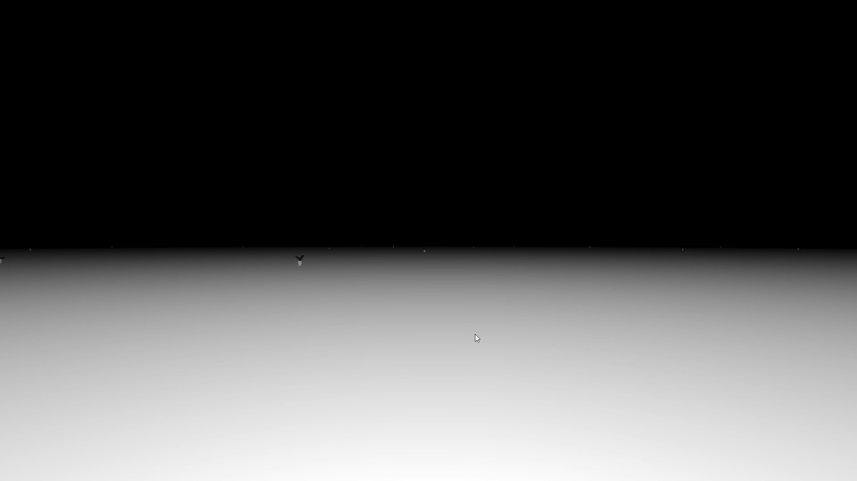
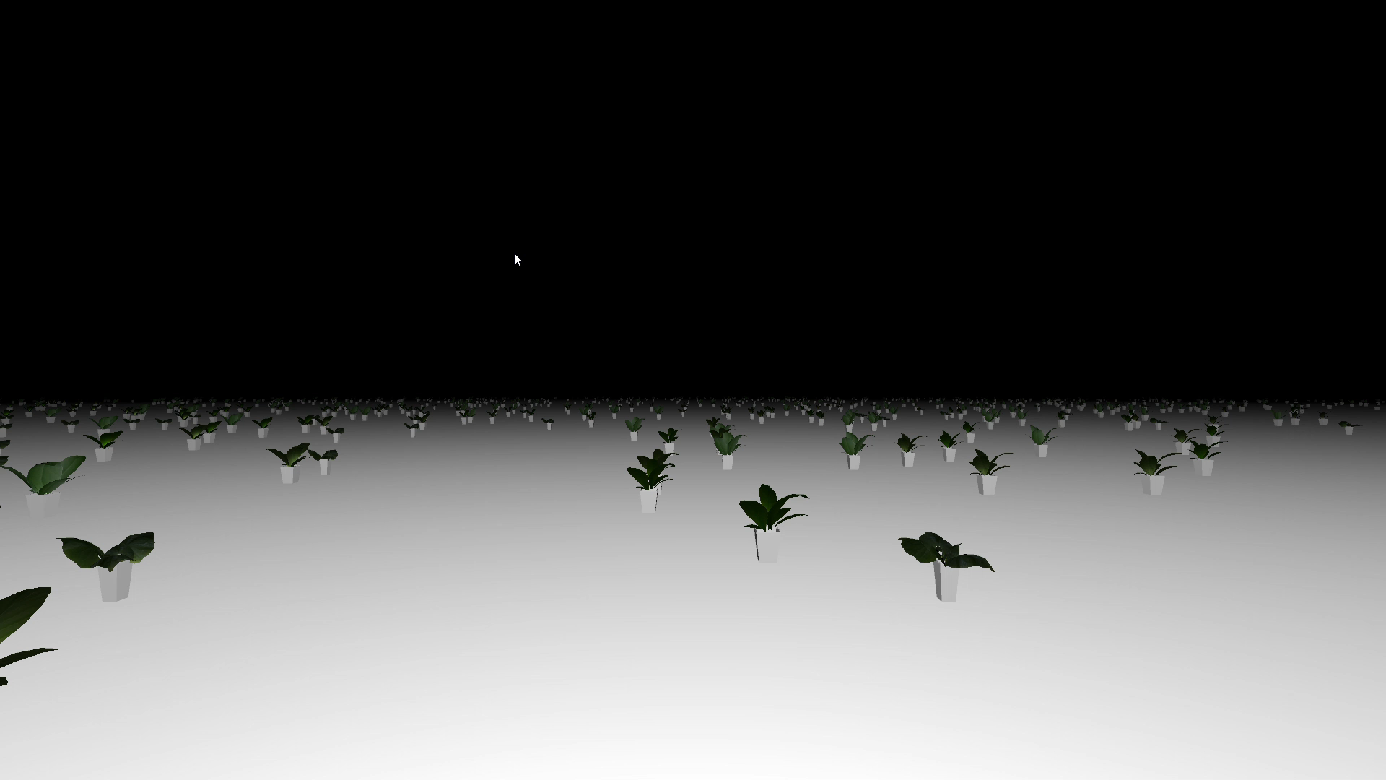
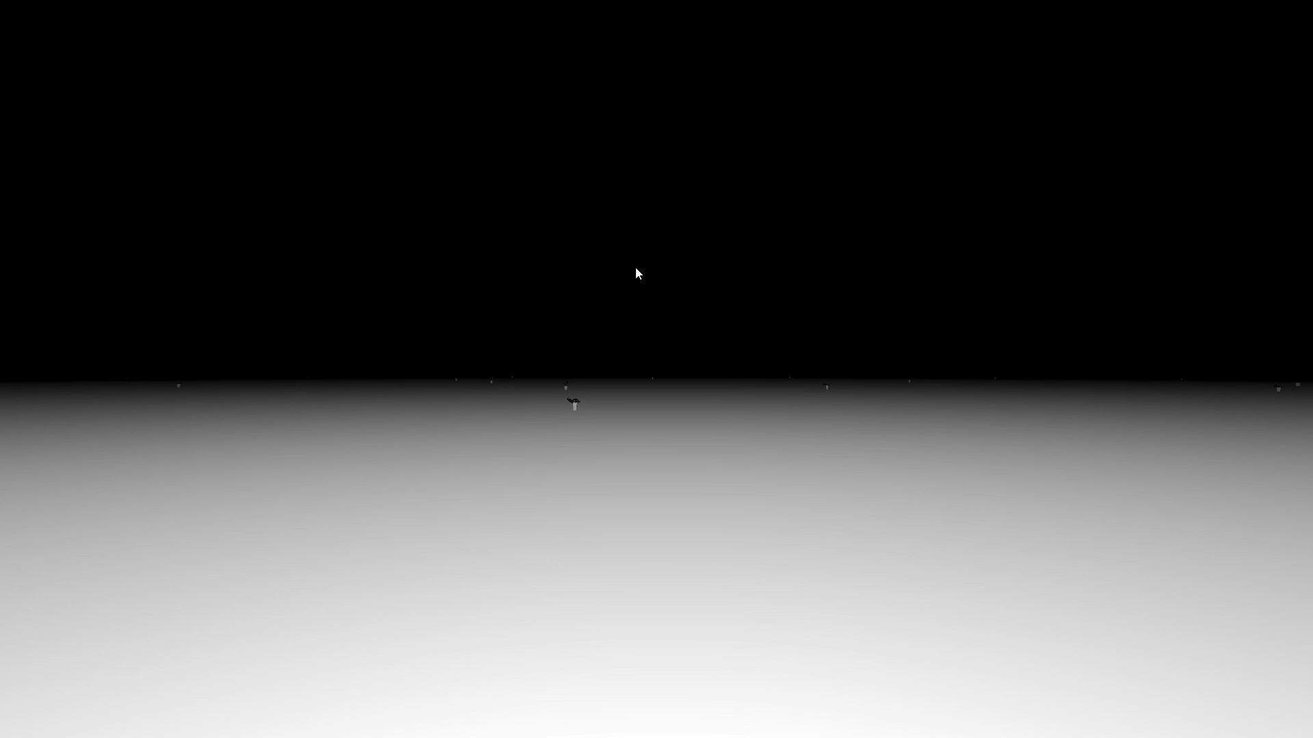
Methods
Pre-Registration
SPARSE
DENSE
SLOW
FAST
Notes:
You can see here that the sparse conditions were REALLY sparse, but since this was a bit of a proof-of-concept, we just wanted to make it REALLY obvious.

Slide 22
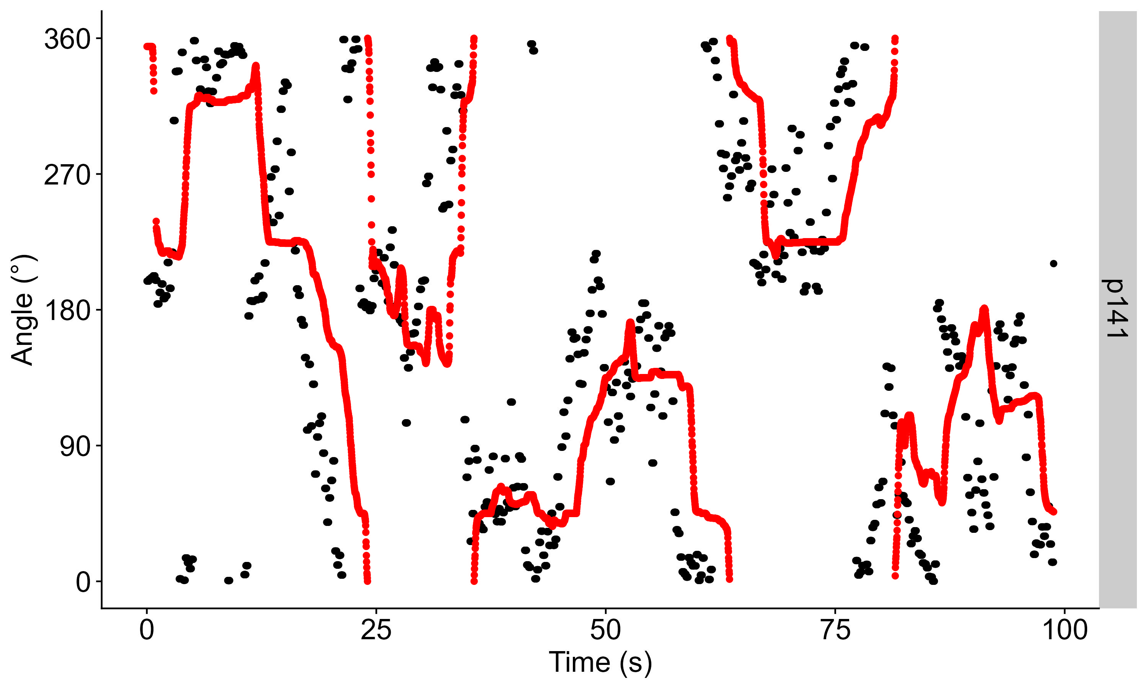
The way to the results
Notes:
So let‘s look at how we get the results. Here is one whole run from one participant, where we have the time in the run on the x axis, the heading angle they were shown in black, and then their joystick response in red.

Slide 23
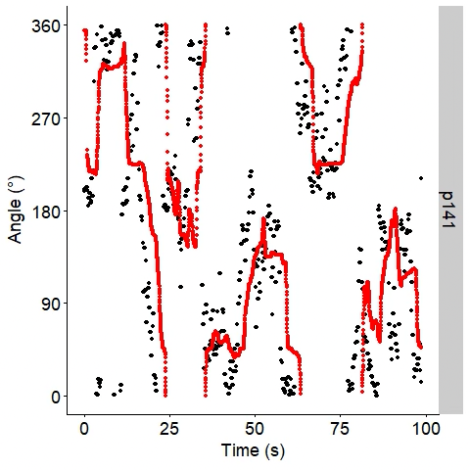
The way to the results
Notes:
Now we can shift the response angles against the presented angle, and then we could compute the correlation for each lag between shown angle and response. Since we were dealing with angles here and 1° and 359° is much more similar than a correlation would assume, we went for a normalized mean error between shown angle and response. We can then plot this normalized difference between shown angle and response for each time lag and what could look as follows:

Slide 24
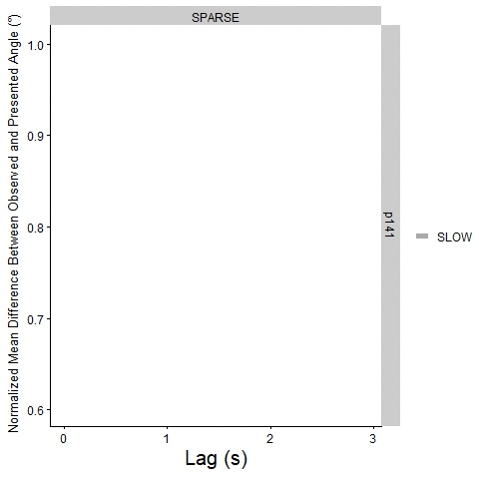
The way to the results
Notes:
So we record the lags on the x axis and then have the mean difference between the two traces here on the y axis, and of course we are interested in these valleys here, i.e., how deep is this valley and which lag marks the volley.

Slide 25
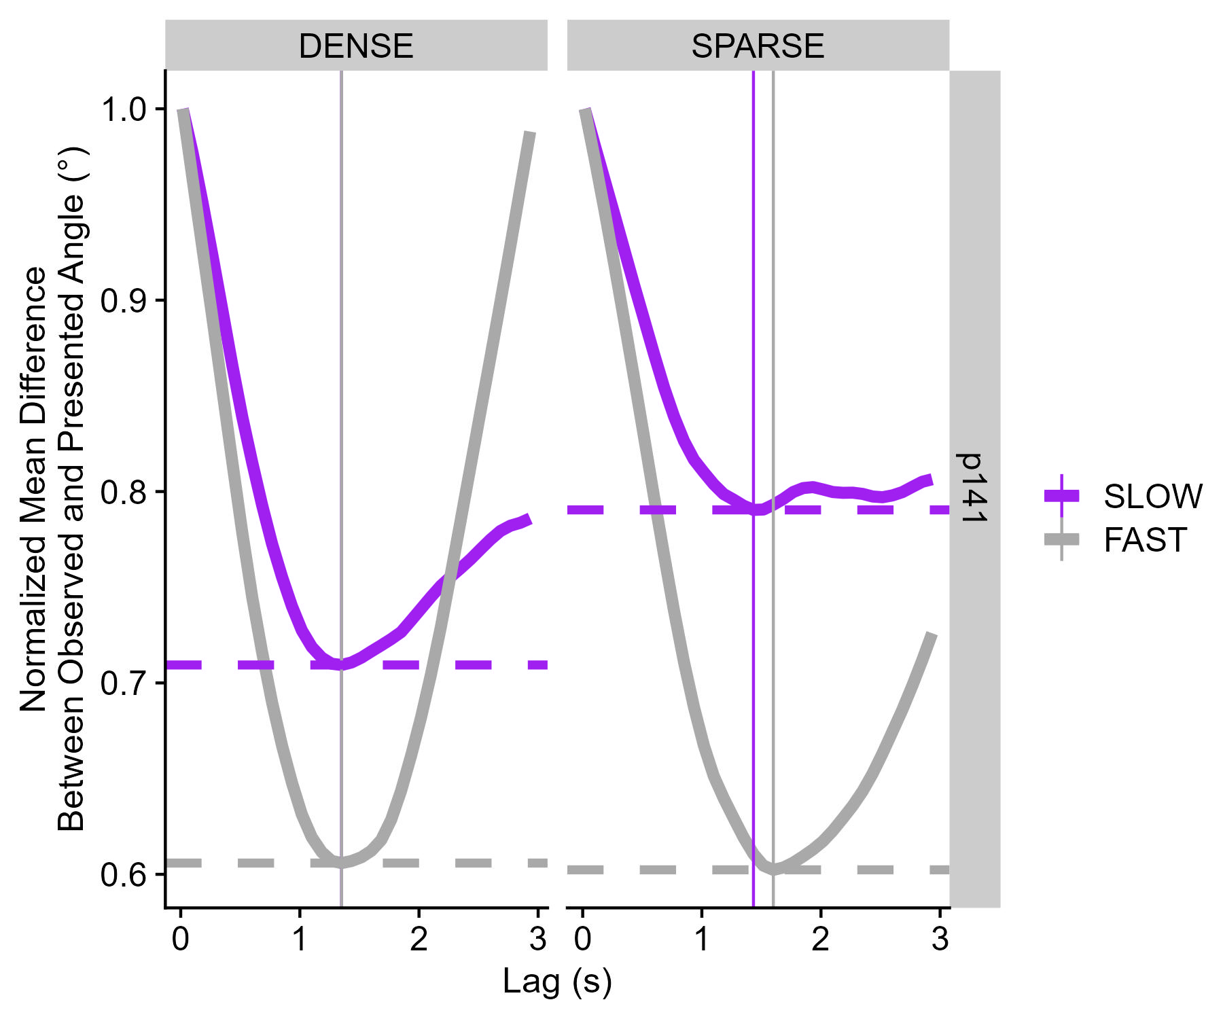
The way to the results
Normalized least error – How precisely are
participants able to respond to changes in heading?
Time lag of least error – how fast do
participants respond to changes
in direction?
Notes:
Now let‘s have a look at this plot for all four conditions for the same participant. We have the speed of self-motion color-coded in purple and grey, and then the density of our little plants divided up into the panels. So to make it explicit, our two dependent variables are what we call the normalized least error, that is, how low the valley goes, and it tells us how precisely participants are responding to the stimulus. And then we have the time lag of least error, which indicates how fast participants respond to the stimulus. And we can already see some differences between the conditions here, but let‘s have a look at the results for all 30 of our participants.

Slide 26
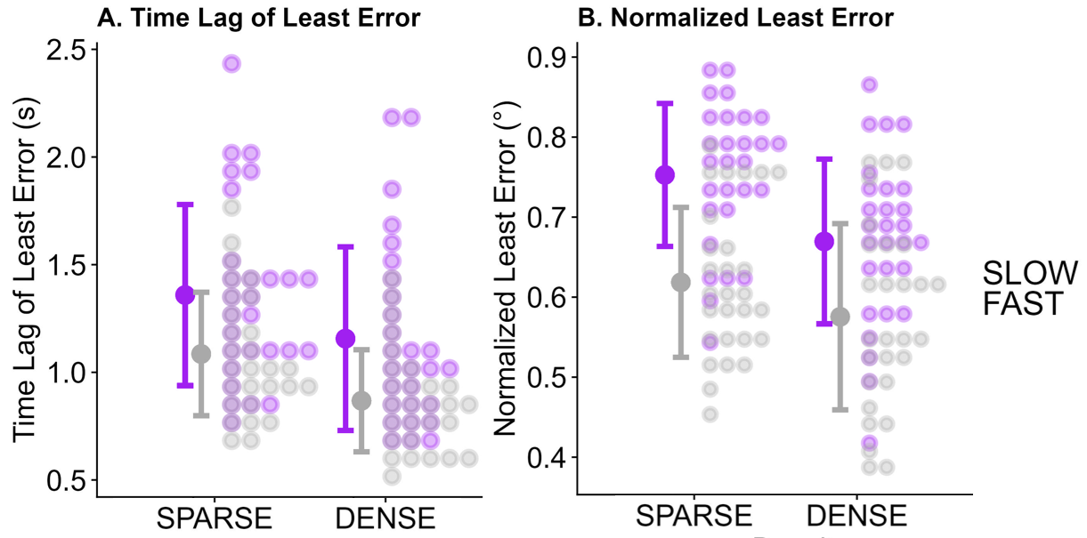
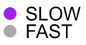
Results
Notes:
On the left we have the results for the time lag of least error, where we can see that, as expected, these reaction times are faster when for higher self-motion speeds, and also they are faster for a denser plant setup. And we find the exact same pattern for the normalized least error, i.e., the precision, where participants are more precised for faster self-motion and a denser plant arrangement.

Slide 27
Statistical analysis
Bootstrap for timing and precision?
1000 sub-samples from the whole dataset (50% participants 25% datapoints)
Obtain Least Difference and Time Lag of Least Difference for each
Statistically analyse each sub-sample
95% confidence intervals are the middle 95% of fitted regression coefficients
Linear Mixed Modelling for precision?
Compute absolute difference between presented angles and response angles at Time Lag of Least Difference
Use Linear Mixed Modelling to determine whether this difference differs between conditions
Can be confounded if there are biases

Slide 28
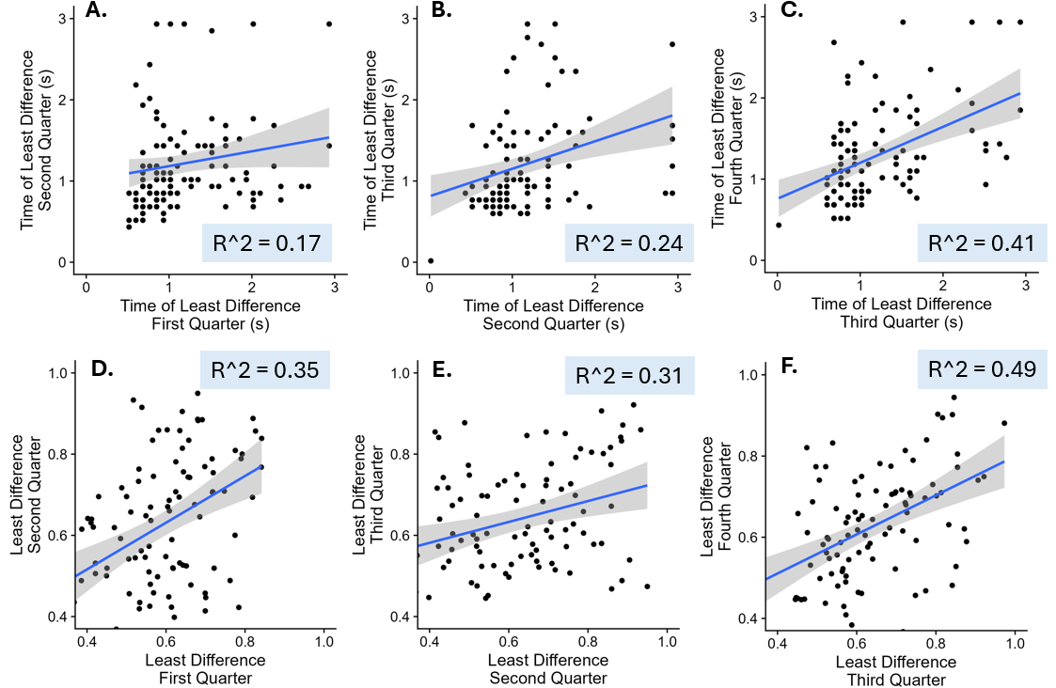
Problems: how stable are the estimates?
How stable is performance across a run of 100s?

Slide 29
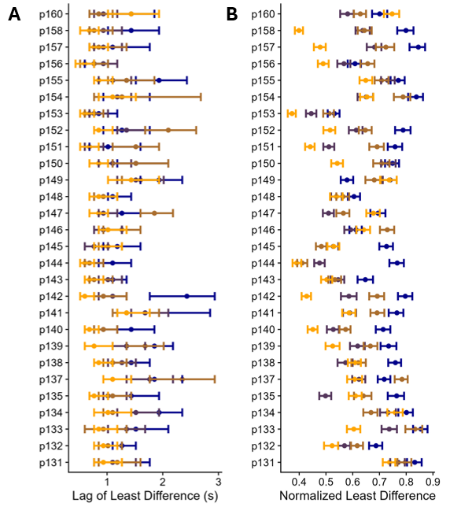
Problems: how stable are the estimates?
How stable is performance across a run of 100s? #2

Slide 30
Not a problem: statistical power
Bootstrap analysis
Even with only 10 participants, most stuff everything comes out significant
 | Difference Contrast | Confidence Interval (Lower Bound) | Confidence Interval (Upper Bound) | Significance
 | Time Lag of Least Difference
FAST (vs. SLOW)
p131-p140 | -0.25s | -0.5s | -0.08s | *
p141-p150 | -0.35s | -0.6s | -0.13s | *
p151-p160 | -0.16s | -0.55s | -0.03s | *
DENSE (vs. SPARSE)
p131-p140 | -0.31s | -0.5s | -0.13s | *
p141-p150 | -0.18s | -0.48s | 0.07s | n.s.
p151-p160 | -0.09s | -0.34s | 0.15s | n.s.
 | Normalized Least Error (Precision)
FAST (vs. SLOW)
p131-p140 | -0.12 | -0.15 | -0.08 | *
p141-p150 | -0.08 | -0.14 | -0.01 | *
p151-p160 | -0.14 | -0.19 | -0.08 | *
DENSE (vs. SPARSE)
p131-p140 | -0.05 | -0.07 | -0.02 | *
p141-p150 | -0.06 | -0.12 | 0.01 | n.s.
p151-p160 | -0.07 | -0.13 | -0.02 | *
Linear Mixed Model analysis
 | Difference Contrast | Confidence Interval (Lower Bound) | Confidence Interval (Upper Bound) | Significance
FAST (vs. SLOW)
p131-p140 | -12.7s | -16.8s | -8.9s | *
p141-p150 | -8.5s | -14s | -4.4s | *
p151-p160 | -12.6s | -16.4s | -9.2s | *
DENSE (vs. SPARSE)
p131-p140 | -5.5° | -8° | -3° | *
p141-p150 | -6.8° | -11.9° | -2.6° | *
p151-p160 | -8.7° | -14° | -3.5° | *

Slide 31
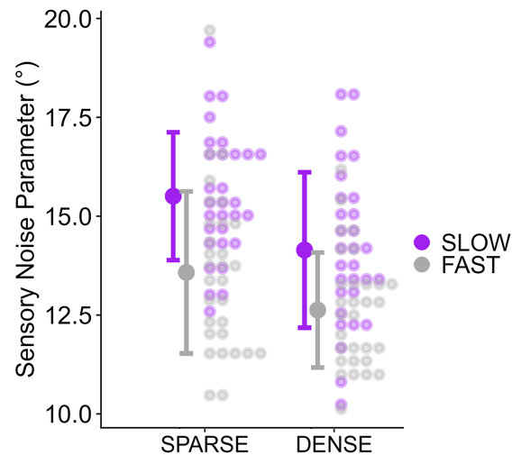
Kalman filter modelling
Kalman filters update a perceptual estimate based on the reliability of a prior and the reliability of the momentary sensory input.
Kalman filters update a perceptual estimate based on the reliability of a prior and the reliability of the momentary sensory input.
Kalman filters update a perceptual estimate based on the reliability of a prior and the reliability of the momentary sensory input.
Kalman filters update a perceptual estimate based on the reliability of a prior and the reliability of the momentary sensory input.
Notes:
The second main analysis that the authors of the seminal paper on Continuous Psychophysics performed was fitting a simple-ish Kalman filter to the data. For time reasons and since this is not the main thrust of this project, I am going to stay at an extreme surface level here and kind of just explain the Kalman filter stuff on a conceptual level. So basically, a Kalman filter maintains a perceptual estimate that it updates based on the reliability of a prior and the reliability of the momentary sensory input. Essentially, when there is not much change in the stimulus, say, for example, if we barely had an direction changes in our stimulus and participants were travelling straight-ahead most of the time, the participant would develop a pretty strong prior that there isn‘t much change in their world. Then, on the other side of the equation, we have the reliability of the momentary sensory input. So if, for example, we take our DENSE-FAST condition, we have a lot of visual information about the participants‘ heading available in any given moment. Now, if the prior is much more reliable than the sensory input, then we update very little, and if the sensory input is much more reliable than the prior, we update a lot. How do we use this model for our analysis? We have the participant‘s perceptual estimate from their responses (i.e., we know how much they update on each step), and we know that participants are fairly good at building a prior from the variability in the random walk. We can use these values and then fit parameters capturing the reliability of the sensory input for each participant and condition. And this is what you see here on the right. Higher numbers mean higher noise, and similar to our other analysis, we found that slower speeds and a more sparse environment are associated with higher sensory noise.

Slide 32
Conclusions
Replicate the known result that more informative optic flow results in higher precision using Continuous Psychophysics
Replicate the known result that more informative optic flow results in higher precision using Continuous Psychophysics
Investigate whether more informative optic flow speeds up perceptual processes
Investigate whether more informative optic flow speeds up perceptual processes
Notes:
So, to sum it up, we replicated the result that more informative optic flow (i.e., faster simulated self-motion, a higher density of objects providing optic flow) leads to higher precision, which is nice as a little sanity check for this novel-ish paradigm, and then we also find data that is consistent with the predictions of drift diffusion models about the speed with which this stimulus is processed and then translated into responses.

Slide 33
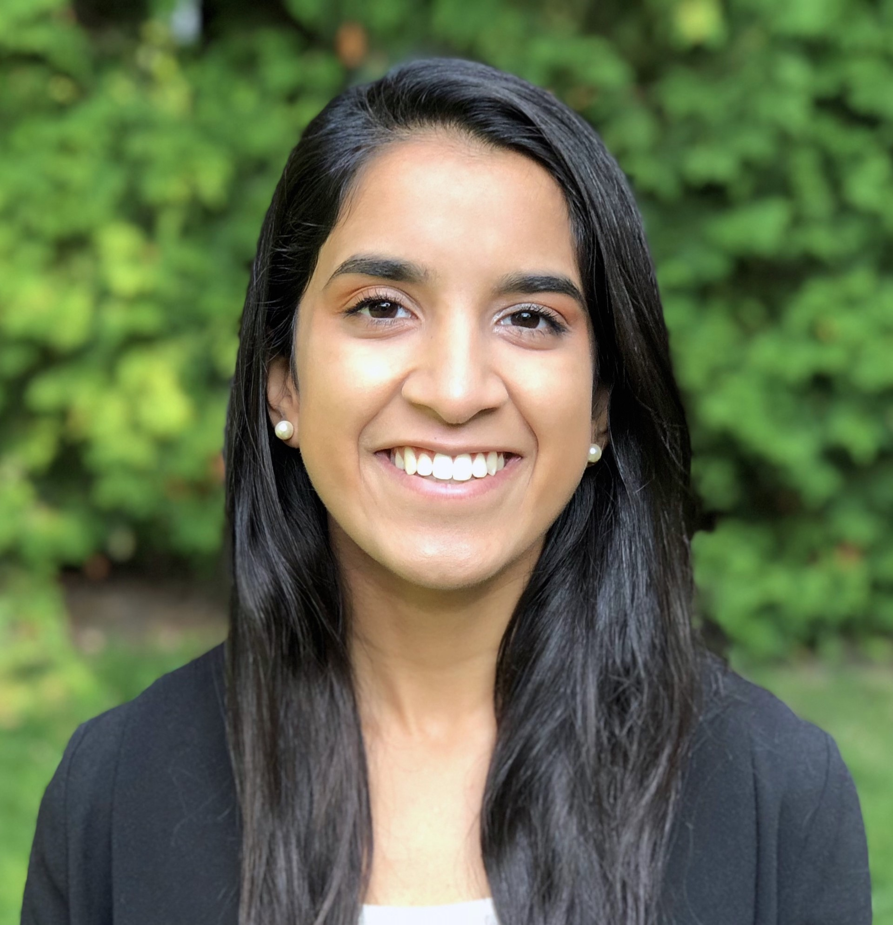
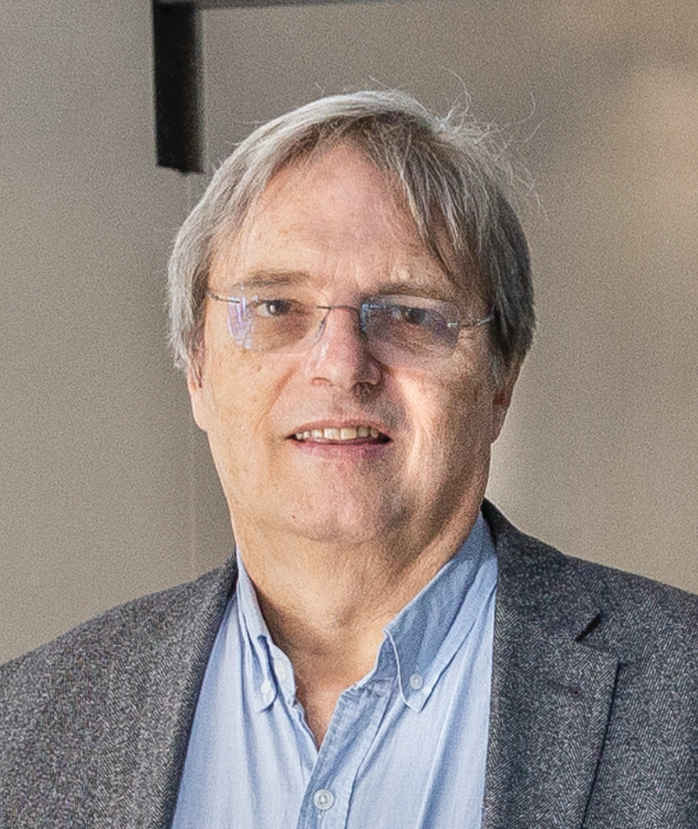
Acknowledgements
Ambika Bansal
Laurence Harris
Notes:
I want to finish by thanking my coauthors, Ambika Bansal, who has a poster on the perception of traveled distance later this week, and Laurence Harris and you, dear audience, for your attention.

